Slide 1
Sequential Circuits

Slide 2
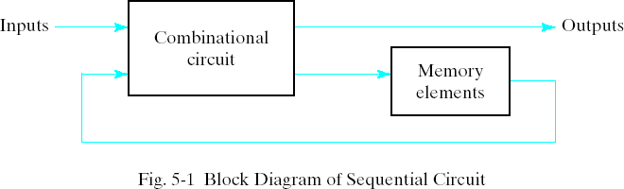
Sequential Circuits
Every digital system is likely to have combinational circuits, most systems encountered in practice also include storage elements, which require that the system be described in term of sequential logic.

Slide 3
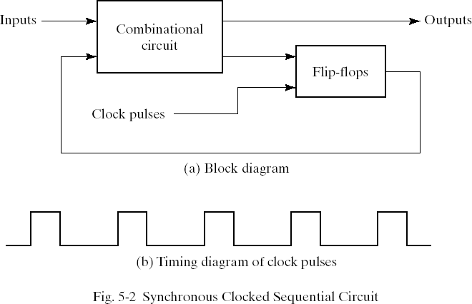
Synchronous Clocked Sequential Circuit
A sequential circuit may use many flip-flops to store as many bits as necessary. The outputs can come either from the combinational circuit or from the flip-flops or both.

Slide 4
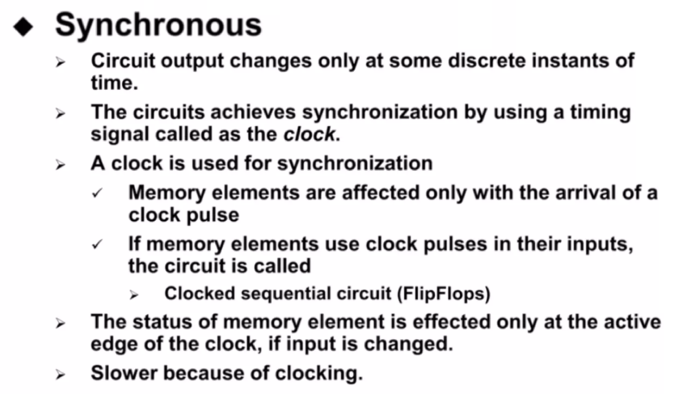
Sequential Circuits Types

Slide 5
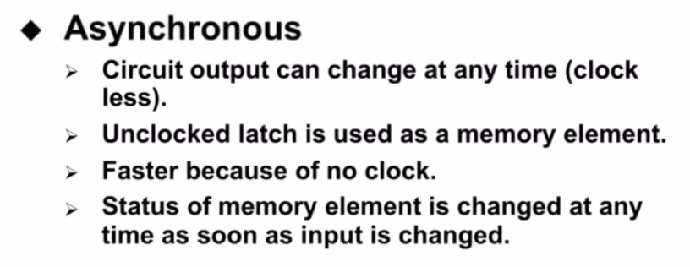
Sequential Circuits Types

Slide 6
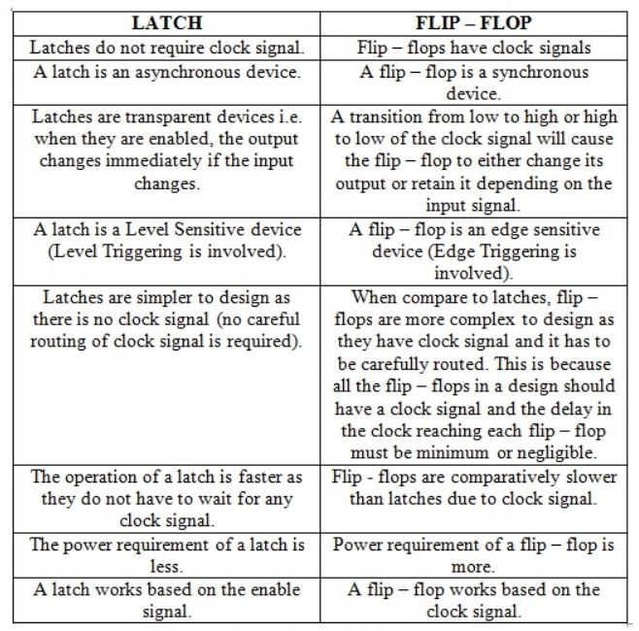
Difference b/w Latch and Flipflop

Slide 7
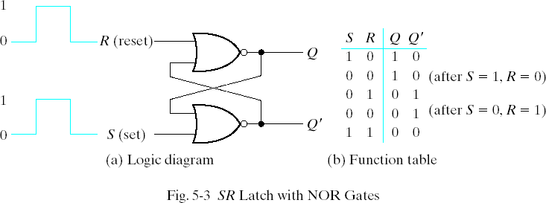
5-2 Latches SR Latch
The SR latch is a circuit with two cross-coupled NOR gates or two cross-coupled NAND gates. It has two inputs labeled S for set and R for reset.

Slide 8
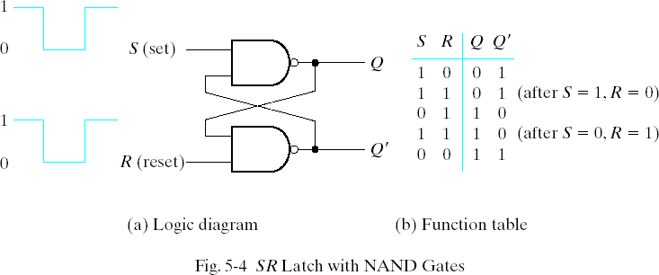
SR Latch with NAND Gates

Slide 9
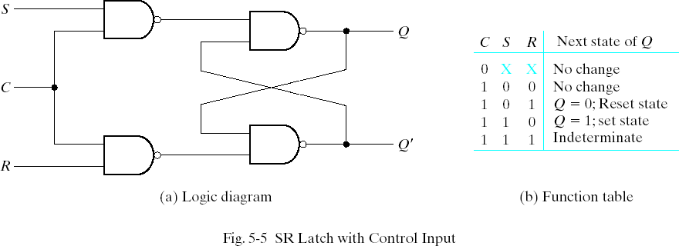
SR Latch with Control Input
The operation of the basic SR latch can be modified by providing an additional control input that determines when the state of the latch can be changed. In Fig. 5-5, it consists of the basic SR latch and two additional NAND gates.

Slide 10
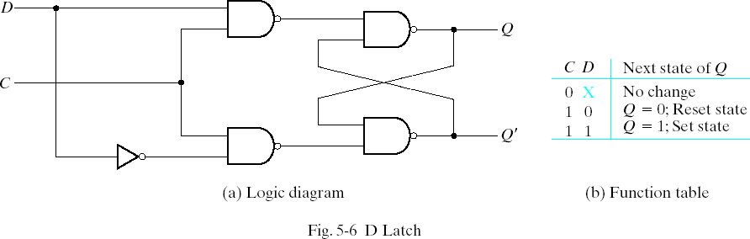
D Latch (Transparent Latch)
One way to eliminate the undesirable condition of the indeterminate state in SR latch is to ensure that inputs S and R are never equal to 1 at the same time in Fig 5-5. This is done in the D latch.

Slide 11
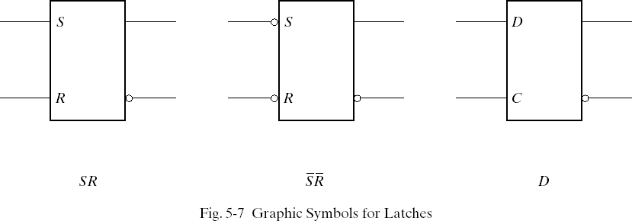
Graphic Symbols for latches
A latch is designated by a rectangular block with inputs on the left and outputs on the right. One output designates the normal output, and the other designates the complement output.

Slide 12
5-3 Flip-Flops
The state of a latch or flip-flop is switched by a change in the control input. This momentary change is called a trigger and the transition it cause is said to trigger the flip-flop. The D latch with pulses in its control input is essentially a flip-flop
that is triggered every time the pulse goes to the logic 1 level. As long as the pulse input remains in the level, any changes in the data input will change the output and the state of the latch.

Slide 13

Clock Response in Latch
In Fig (a) a positive level response in the control input allows changes, in the output when the D input changes while the clock pulse stays at logic 1.

Slide 14
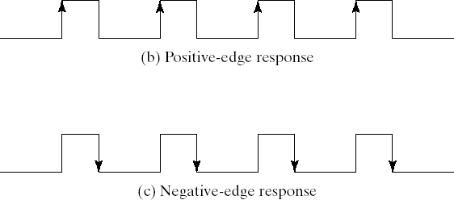
Clock Response in Flip-Flop

Slide 15
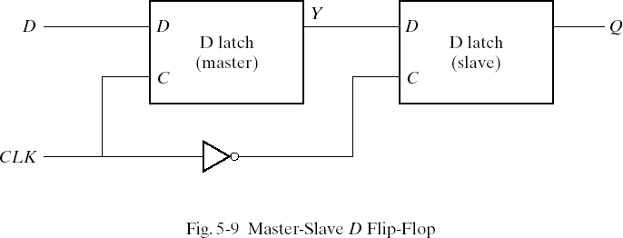
Edge-Triggered D Flip-Flop
The first latch is called the master and the second the slave. The circuit samples the D input and changes its output Q only at the negative-edge of the controlling clock.
D 1 1 0 0 1 1 …
Y 1 1 0 0 1 1 …
Q ? 1 1 0 0 1 ….
CLK

Slide 16
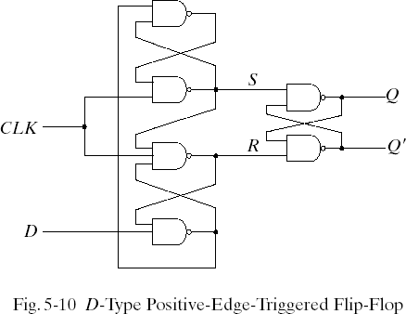
D-Type Positive-Edge-Triggered Flip-Flop
Another more efficient construction of an edge-triggered D flip-flop uses three SR latches. Two latches respond to the external D(data) and CLK(clock) inputs. The third latch provides the outputs for the flip-flop.

Slide 17
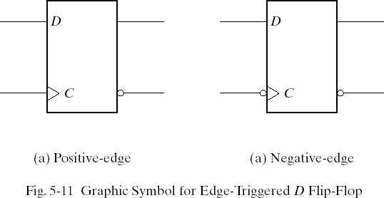
Graphic Symbol for Edge-Triggered D Flip-Flop

Slide 18
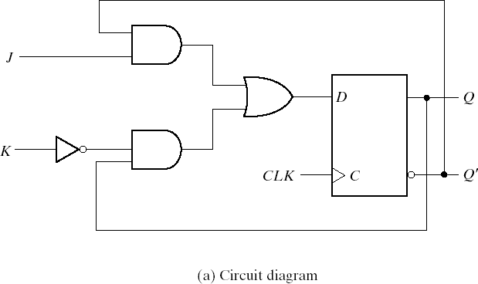
Other Flip-Flops JK Flip-Flop
There are three operations that can be performed with a flip-flop: set it to 1, reset it to 0, or complement its output. The JK flip-flop performs all three operations. The circuit diagram of a JK flip-flop constructed with a D flip-flop and gates.

Slide 19
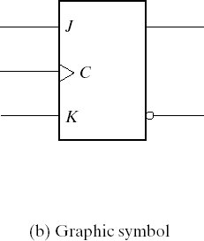
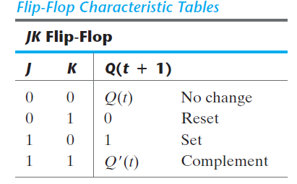
JK Flip-Flop
The J input sets the flip-flop to 1, the K input resets it to 0, and when both inputs are enabled, the output is complemented. This can be verified by investigating the circuit applied to the D input:
D = J Q` + K` Q

Slide 20
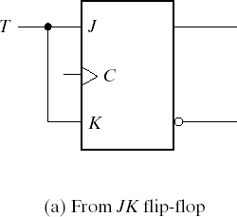
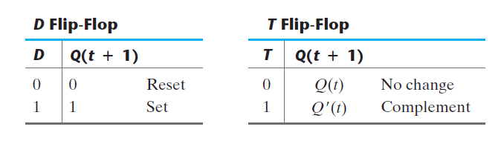
T Flip-Flop
The T(toggle) flip-flop is a complementing flip-flop and can be obtained from a JK flip-flop when inputs J and K are tied together.

Slide 21
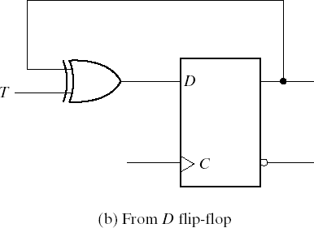
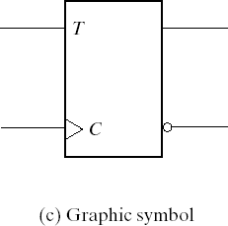
T Flip-Flop
The T flip-flop can be constructed with a D flip-flop and an exclusive-OR gates as shown in Fig. (b). The expression for the D input is
D = T Q = TQ` + T`Q

Slide 22
Characteristic Equations
D flip-flop Characteristic Equations
Q(t + 1) = D
JK flip-flop Characteristic Equations
Q(t + 1) = JQ` + K`Q
T flip-flop Characteristic Equations
Q(t + 1) = T Q = TQ` + T`Q

Slide 23
Direct Inputs
Some flip-flops have asynchronous inputs that are used to force the flip-flop to a particular state independent of the clock. The input that sets the flip-flop to 1 is called present or direct set. The input that clears the flip-flop to 0 is called clear or direct reset. When power is turned on a digital system, the state of the flip-flops is unknown. The direct inputs are useful for bringing all flip-flops in the system to a known starting state prior to the clocked operation.

Slide 24
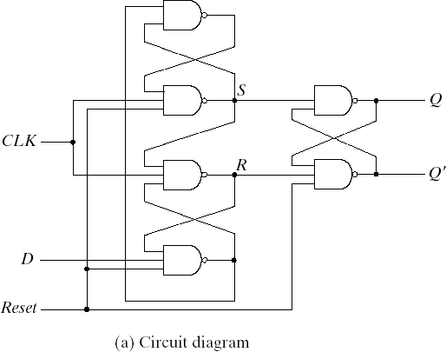
D Flip-Flop with Asynchronous Reset
A positive-edge-triggered D flip-flop with asynchronous reset
is shown in Fig(a).

Slide 25
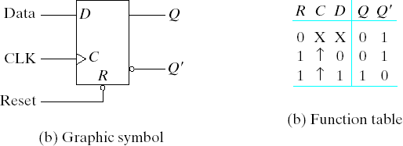
D Flip-Flop with Asynchronous Reset

